Slide 1

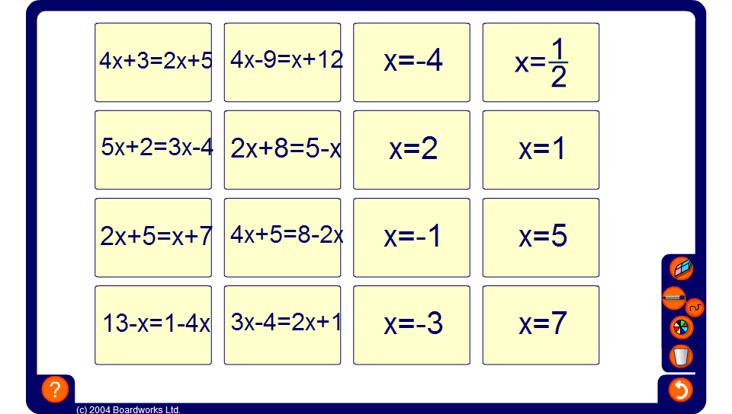


Equation match
Notes:
Select a volunteer to come to the board to match an equation to a solution. Pupils may chose to partially solve the equation and then use substitution to check the answer. Discuss the methods used.
Select a different volunteer to come to the board each time. Classmates may make suggestions. Towards the end the solution can be found by substituting each remaining solution into the required equation until the equation balances.

